Slide 1
Machine Learning Algorithms (IV)
Master´s in Applied Artificial Intelligence
Luís Ferreira
lufer@ipca.pt

Slide 2
Overview
Part I
Artificial Intelligence and Machine Learning
Foundations
Part II
Machine Learning
Part III
Machine Learning Algorithms
Parte IV
Advanced ML
Parte V
Building a ML Model

Slide 3
Part IV
Machine Learning Algorithms
Competencies to be acquired:
Choosing ML Algorithms
Classification Multi Labels ML models

Slide 4
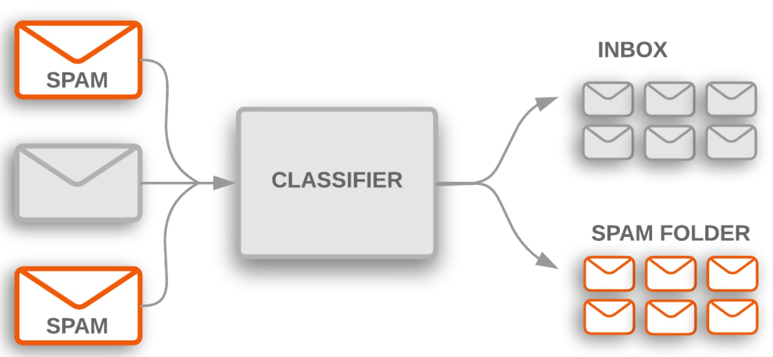
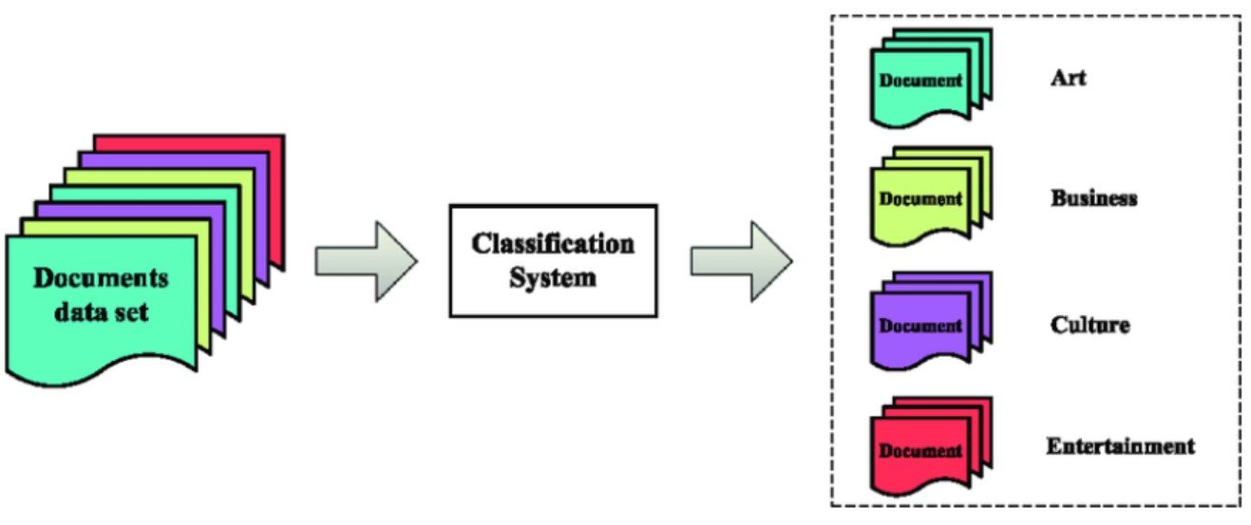
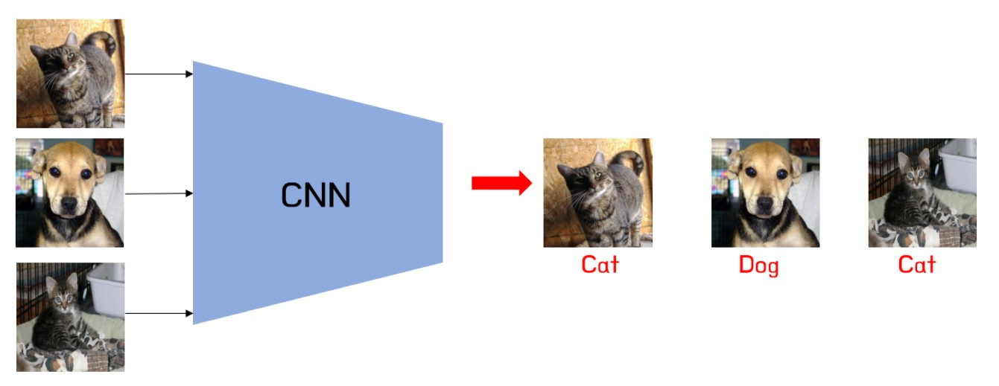
Part IV: MLA
Modelling for Classification
Classification Examples
  Customer behaviour prediction
  Document classification
  Spam filtering
  Image classification
  Web text classification
  Product categorization
  Image sentiment analysis
Notes:
https://vitalflux.com/classification-problems-real-world-examples/

Slide 5
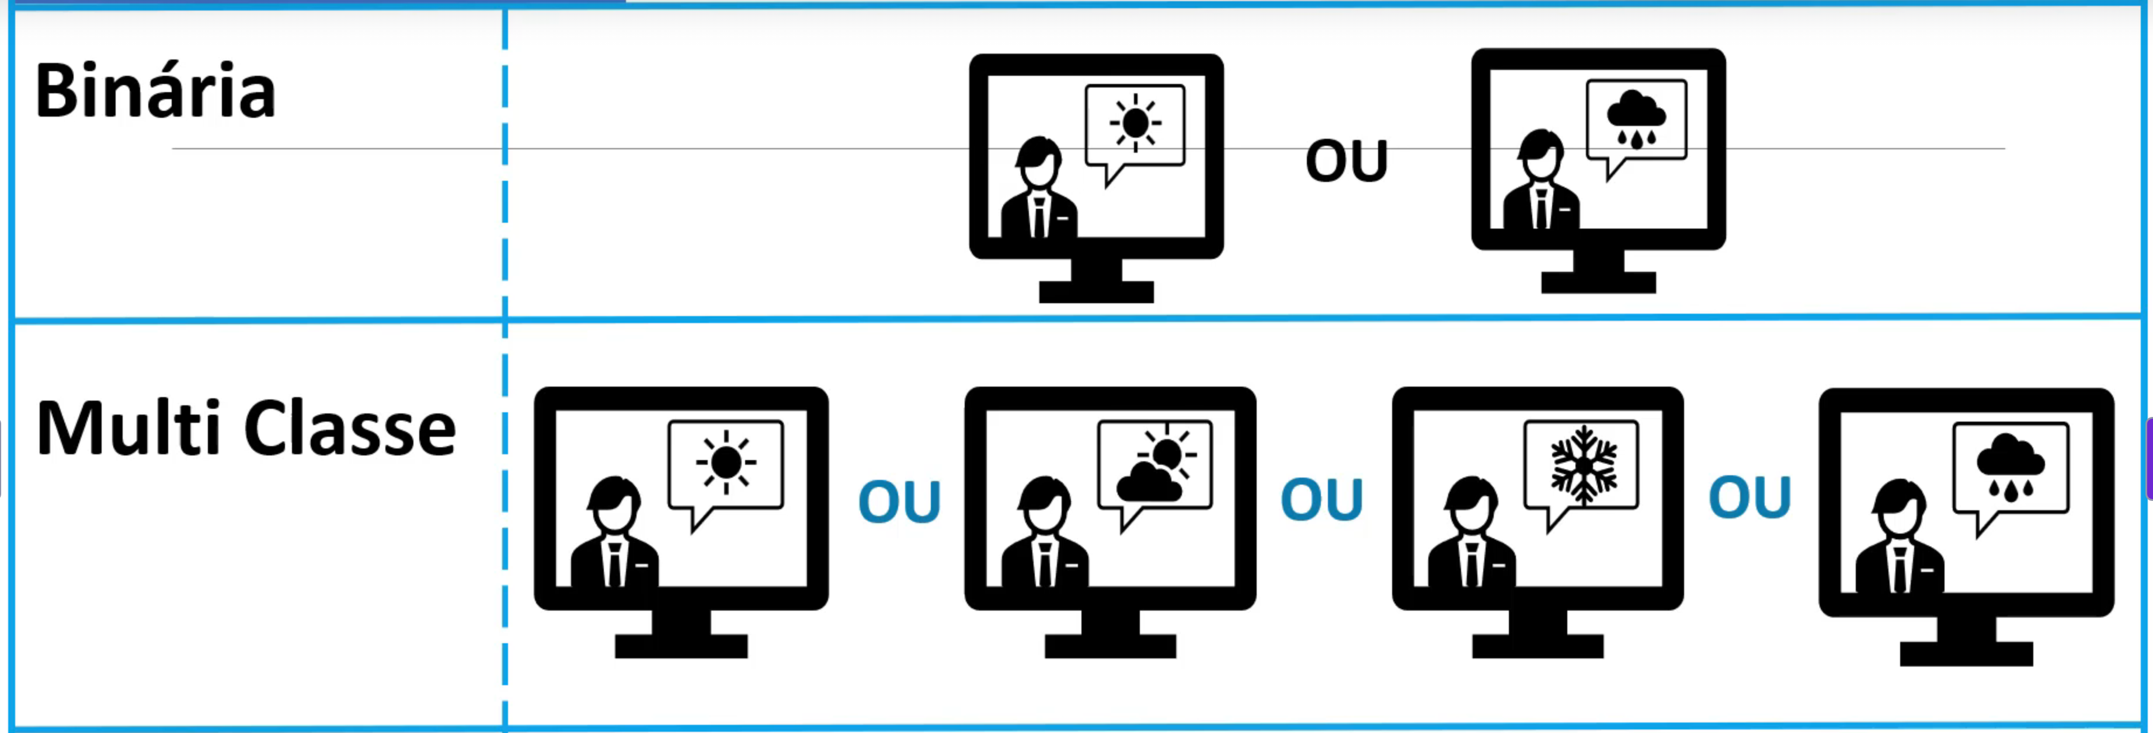
Part IV: MLA
Modelling for Classification
Classification
  Simple or Binary
    Only two classes: yes/no; rainy/sunny
  Multi Class
    One of many classes: rainy/sunny/cloudy
Multi-class classification techniques: (Explore!)
transformation to binary
extension from binary
hierarchical classification
Notes:
https://vitalflux.com/classification-problems-real-world-examples/

Slide 6

Part IV: MLA
Modelling for Classification
Classification
  Simple or Binary
    Only two classes: yes/no; rainy/sunny
  Multi Class
    One of many classes: rainy/sunny/cloudy
  Multi Label
    Multiple combinations
Notes:
https://vitalflux.com/classification-problems-real-world-examples/

Slide 7
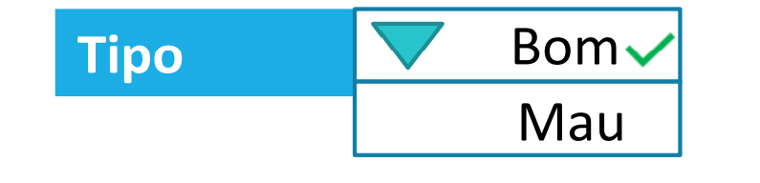
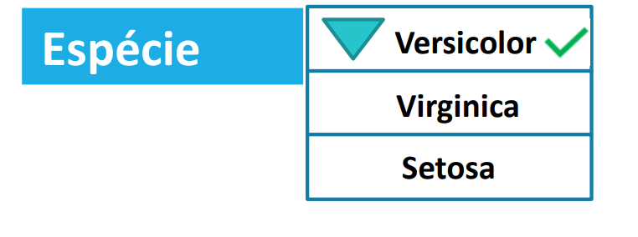
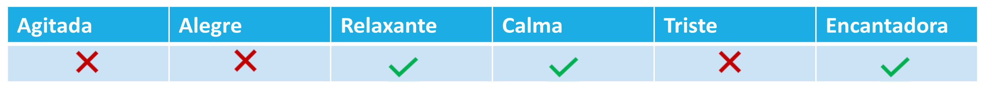
Part IV: MLA
Modelling for Classification
Classification
  Simple or Binary
    Only two classes: yes/no; rainy/sunny
  Multi Class
    One of many classes: rainy/sunny/cloudy
  Multi Label
    Multiple combinations
Notes:
https://vitalflux.com/classification-problems-real-world-examples/

Slide 8
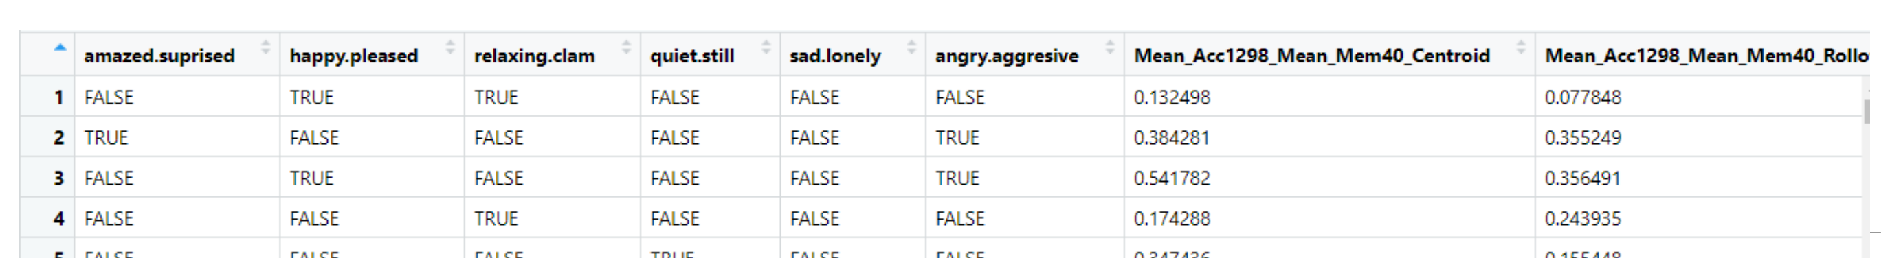
Part IV: MLA
Modelling for Classification
Classification Multi-Label
Data about types of music
Classes
Attributes
Notes:
https://vitalflux.com/classification-problems-real-world-examples/

Slide 9
Part IV: MLA
Modelling for Classification
Classification Multi-Label
Data about types of music
Classes
Attributes
Notes:
https://vitalflux.com/classification-problems-real-world-examples/

Slide 10
Part IV: MLA
Modelling for Classification
Classification Multi-Label
Alternatives:
Problem Transformation (data adapted to the model)
Adapting Algorithms (model adapted to the data)
Notes:
https://vitalflux.com/classification-problems-real-world-examples/

Slide 11
Part IV: MLA
Modelling for Classification
Classification Multi-Label
Problem Transformation (data adapted to the model)
  Binary relevance
  Classifier Chains
  Label Powerset
Notes:
https://vitalflux.com/classification-problems-real-world-examples/

Slide 12
Part IV: MLA
Modelling for Classification
Classification Multi-Label
Adapting Algorithms (model adapted to the data)
  Clare (C4.5)
  AdaBoost.MH
  ML-kNN
Notes:
https://vitalflux.com/classification-problems-real-world-examples/

Slide 13
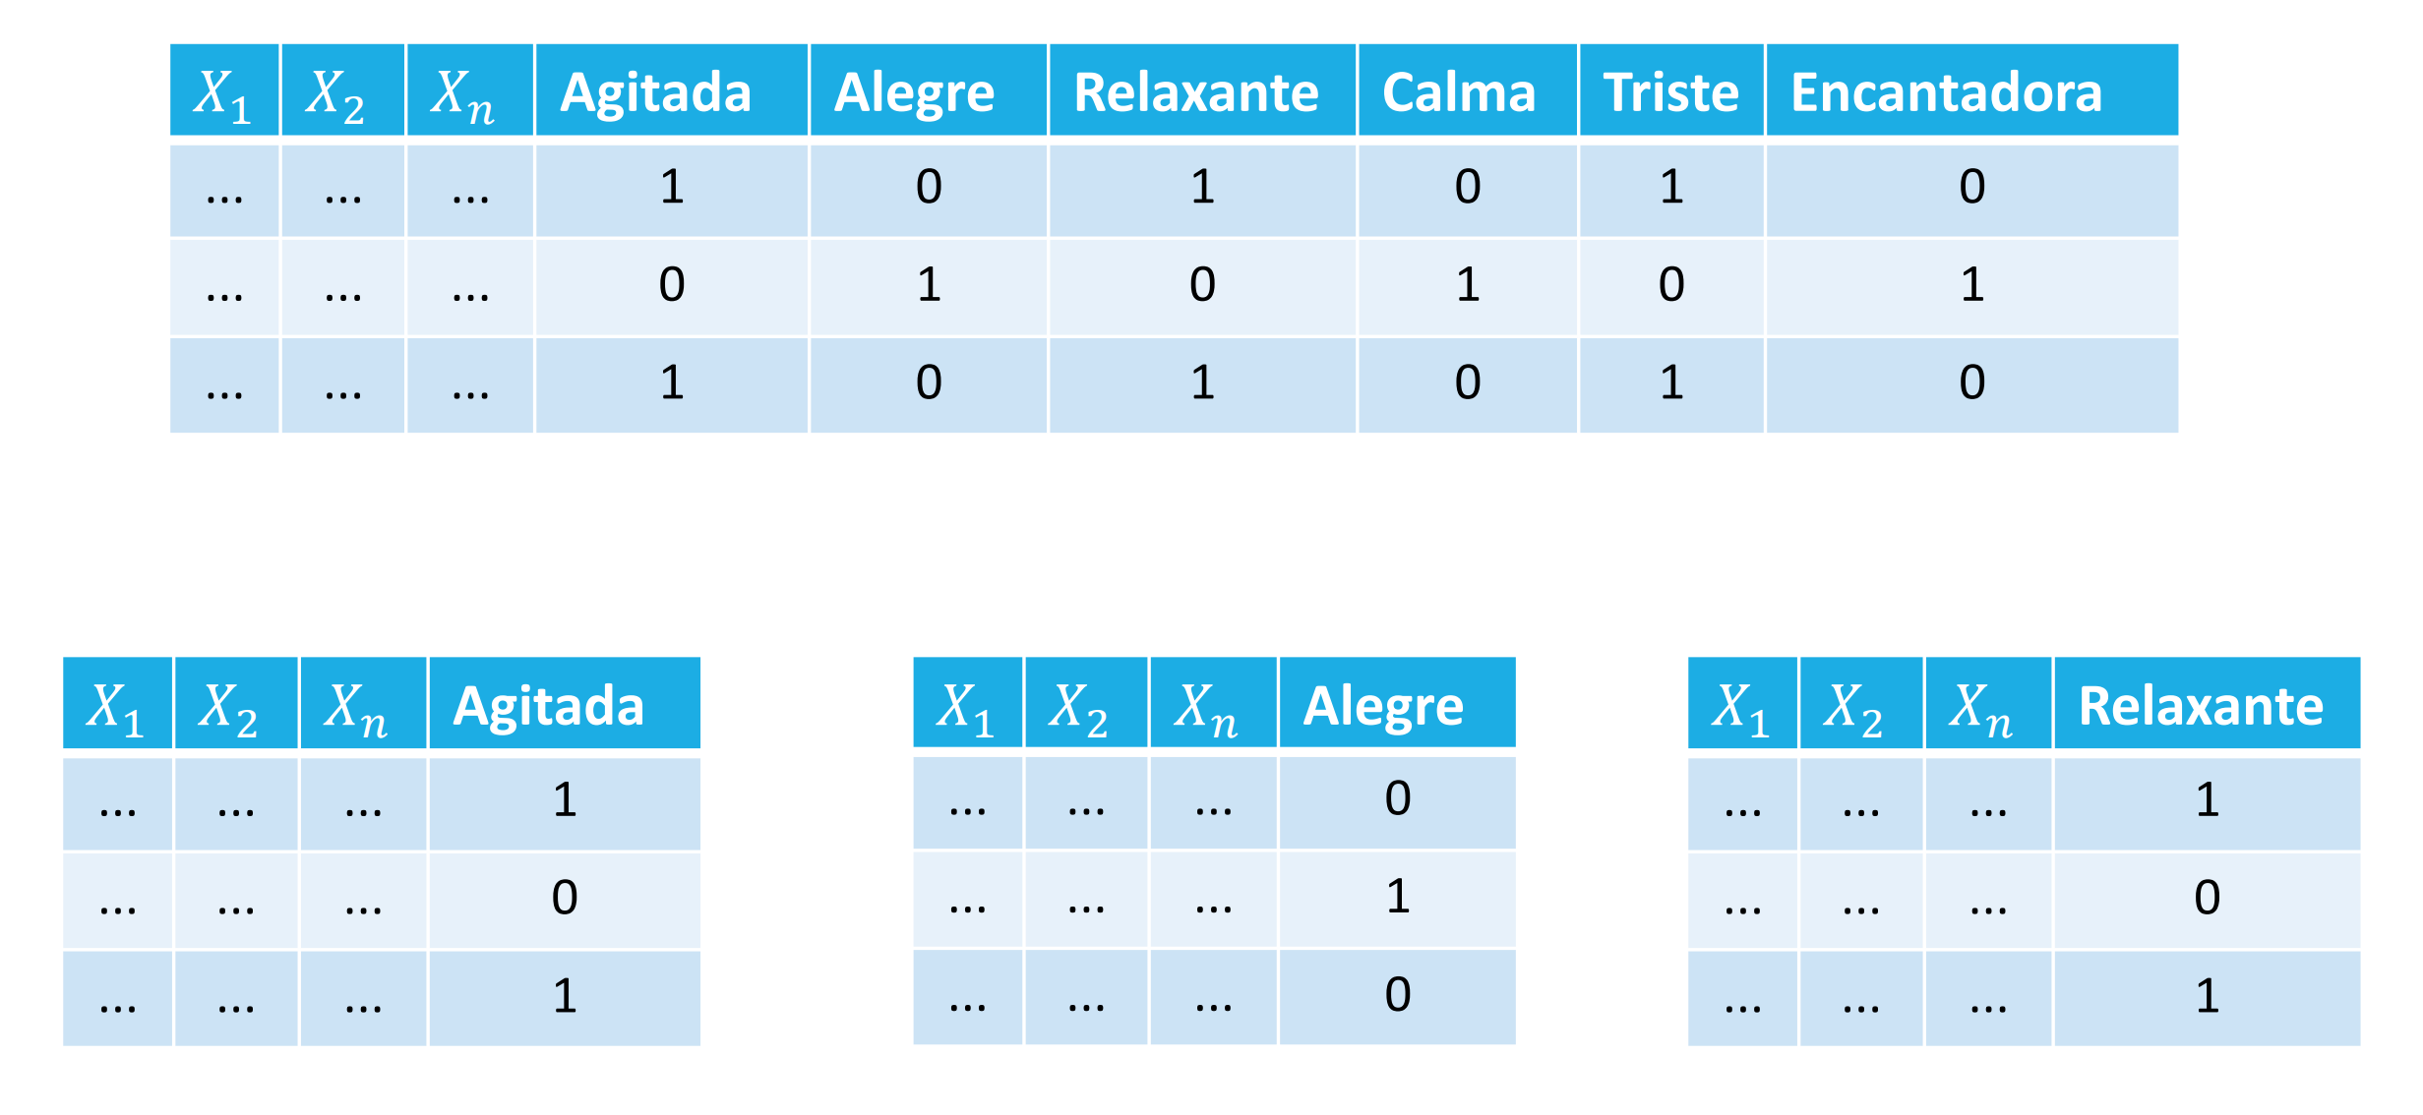
Part IV: MLA
Modelling for Classification
Classification Multi-Label - Problem Transformation
Binary relevance
Each class individually
classified....
Notes:
https://vitalflux.com/classification-problems-real-world-examples/

Slide 14
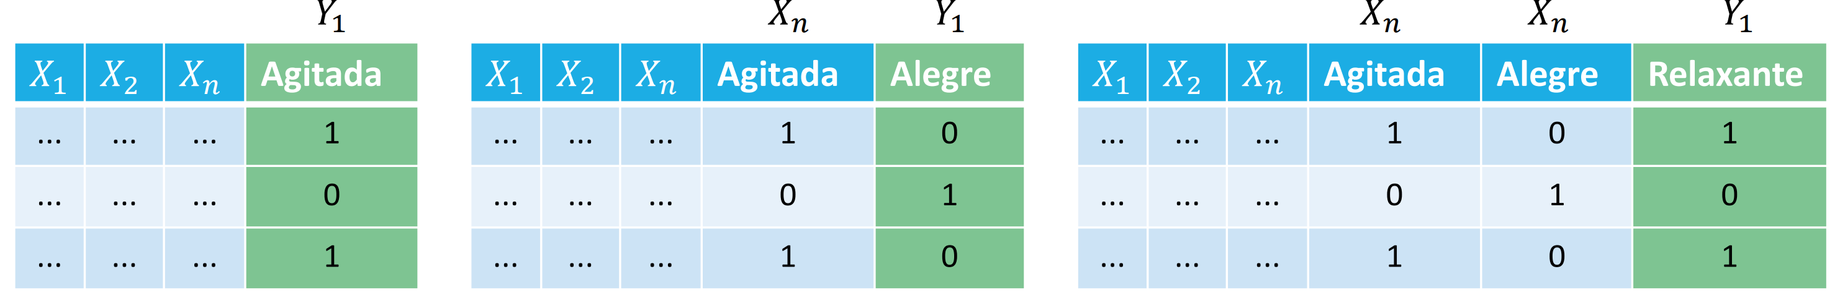
Part IV: MLA
Modelling for Classification
Classification Multi-Label - Problem Transformation
Classifier Chains
The class individually classified is
attribute for following tests…
Notes:
https://vitalflux.com/classification-problems-real-world-examples/

Slide 15
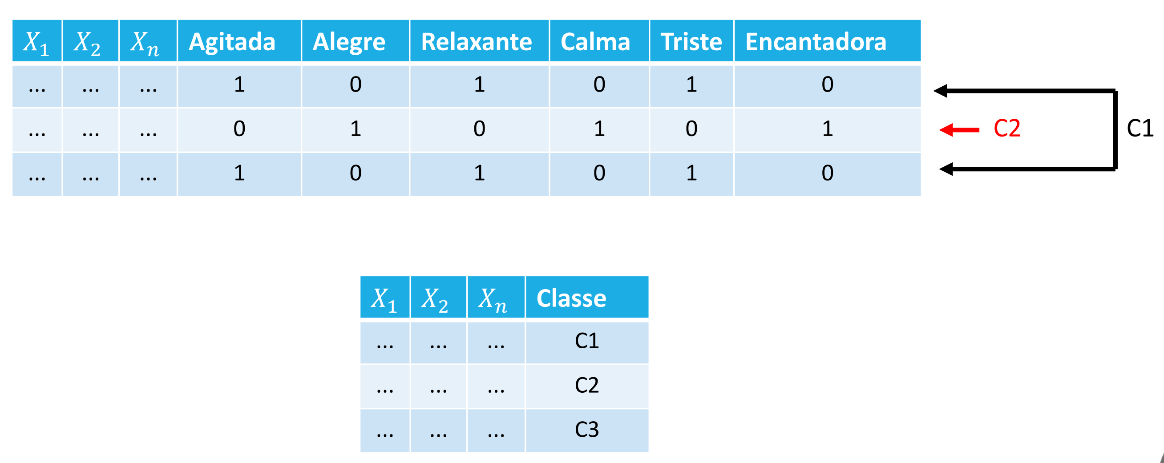
Part IV: MLA
Modelling for Classification
Classification Multi-Label - Problem Transformation
Label Powerset
Create new class label with
each label’s value sequence…

Slide 16
Part IV: MLA
Modelling for Classification
Classification Multi-Label - Evaluation
Exact Match
Hamming Loss (HL)
Hamming Distance
See: https://en.wikipedia.org/wiki/Multi-label_classification

Slide 17
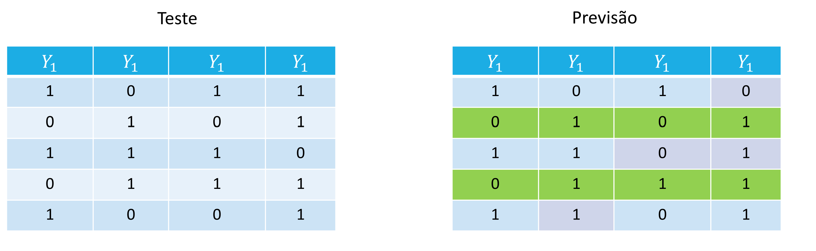
Part IV: MLA
Modelling for Classification
Classification Multi-Label - Exact Match (Subset Accuracy)
Only sequence of all correct
Exact Match
0
1
0
1
0

Slide 18
Part IV: MLA
Modelling for Classification
Classification Multi-Label - Exact Match (Subset Accuracy)
Only sequence of all correct
Use Cases
  Used in multi-label tasks where a completely correct prediction is necessary.
  Often too strict, especially when the number of labels is large.
Instance | True Label | Predicted Label | Exact Match
1 | [1, 0, 1] | [1, 0, 1] | 1
2 | [1, 1, 0] | [1, 0, 0] | 0
Exact Match=(1+0)/2 = 0.5

Slide 19
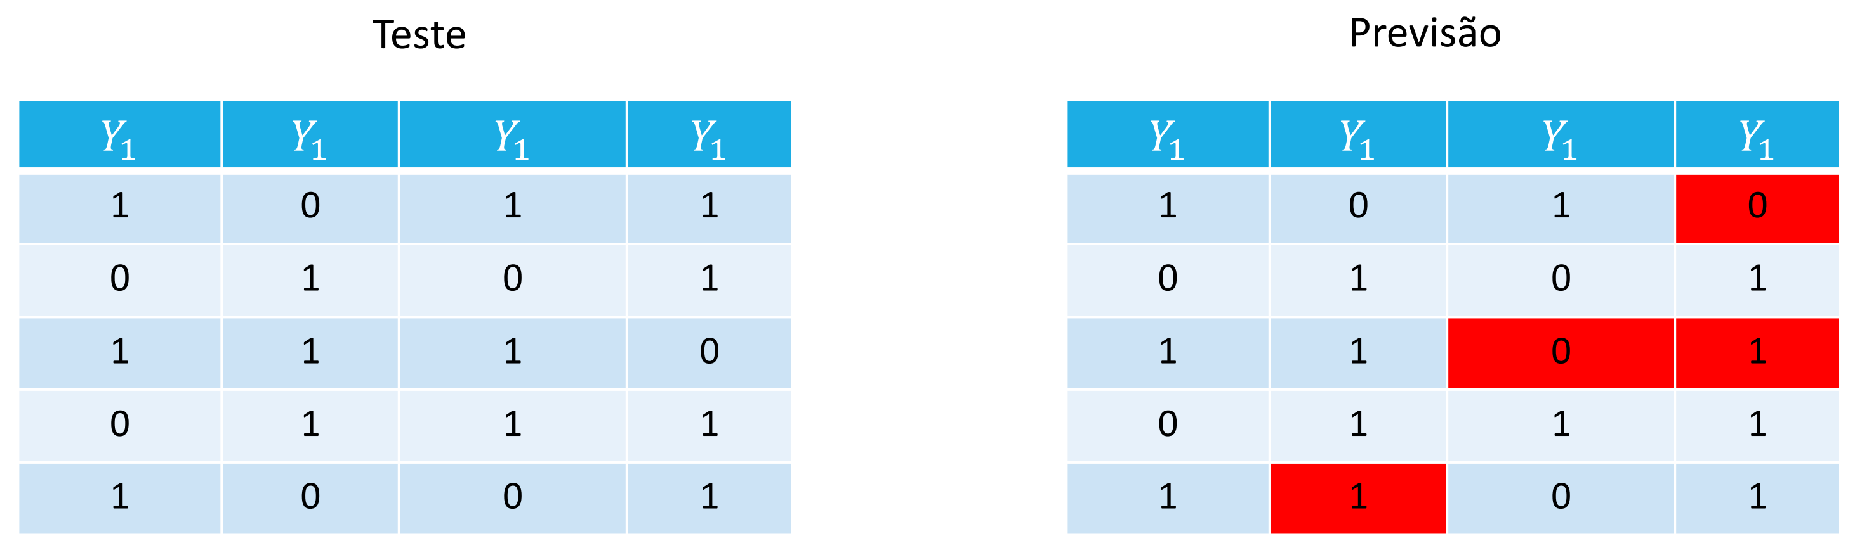
Part IV: MLA
Modelling for Classification
Classification Multi-Label - Hamming Loss (HL)
The fraction of the wrong labels to the total number of labels
Give each label equal weight
HL = (1+0+2+0+1)/20=0.2

Slide 20
Part IV: MLA
Modelling for Classification
Classification Multi-Label - Hamming Loss (HL)
The fraction of the wrong labels to the total number of labels
Give each label equal weight
HL = 4/20=0.2
Use Cases:
  Multi-label classification (e.g., document categorization, image tagging).
  Measuring classification performance in cases where multiple labels can be assigned.
True labels: [1, 0, 1]
Predicted labels: [0, 0, 1]
HL=2/6 = 0.33

Slide 21
Part IV: MLA
Modelling for Classification
Classification Multi-Label - Hamming Loss (HL) & Exact Match
Instance | True Label | Predicted Label | Hamming Loss | Hamming Distance | Exact Match
1 | [1, 0, 1] | [1, 1, 1] | 0.33 (1/3) | 1 | 0
2 | [0, 1, 0] | [0, 1, 1] | 0.33 (1/3) | 1 | 0
3 | [1, 1, 1] | [1, 0, 1] | 0.33(1/3) | 1 | 0
Total |  |  | (1+1+1)/9=0.33 | 3 | =(0+0+0)/3=0

Slide 22
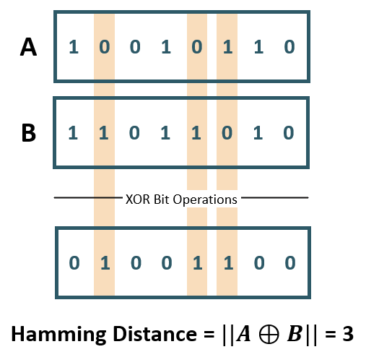
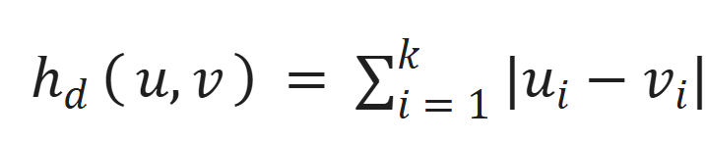
Part IV: MLA
Modelling for Classification
Classification Multi-Label - Hamming Distance H_{d}​(A,B)
Measures how many positions differ between two equal-length binary strings (or sequences), i.e., the number of places in which the two strings differ
h_{d}​=1
h_{d}​=2
h_{d}​=1
A = 11010
B = 10011
Hamming Distance = 2 (because two bits differ)

Slide 23
Part IV: MLA
Modelling for Classification
Classification Multi-Label - Hamming Distance H_{d}​(A,B)
Measures how many positions differ between two equal-length binary strings (or sequences), i.e., the number of places in which the two strings differ
Use Cases:
  Error detection (e.g., in coding theory and telecommunications).
  String similarity measurement (e.g., DNA sequencing, NLP).
h_{d}​=1
h_{d}​=2
h_{d}​=1
See “Levenshtein distance”; ”Jaccard similarity”

Slide 24
Part IV: MLA
Modelling for Classification
Classification Multi-Label – HD versus HL
Feature | Hamming Distance | Hamming Loss
Definition | Counts total differences between two strings | Measures fraction of incorrect labels
Range | Integer (from 000 to length of the string) | Float (from 000 to 111)
Use Case | String comparison, error correction | Multi-label classification evaluation
Applicable to | Binary sequences (or categorical data) | Multi-label classification problems

Slide 25
Progress
Part I
Artificial Intelligence and Machine Learning
Foundations
Part II
Machine Learning
Part III
Machine Learning Algorithms (I)
Part IV
Machine Learning Algorithms (I)
Part V
Advanced ML

Slide 26
References
Machine Learning. Tom M. Mitchel, McGraw-Hill, 1997
Machine Learning for Everyone
  https://vas3k.com/blog/machine_learning/
Machine Learning Tutorial
  https://www.simplilearn.com/tutorials/machine-learning-tutorial/machine-learning-steps
What is machine learning and how does it work? In-depth guide
  https://www.techtarget.com/searchenterpriseai/definition/machine-learning-ML

Slide 27
Appendices

Slide 28
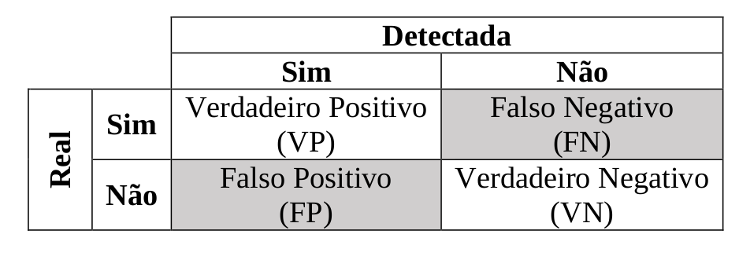
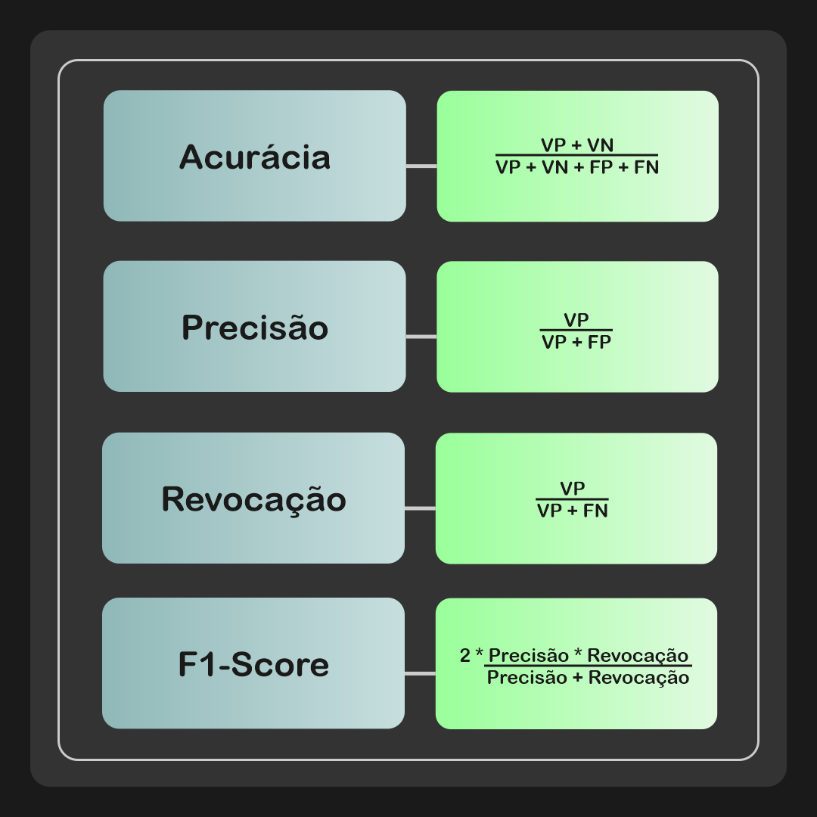
Accuracy: indica a performance geral do modelo. De entre todas as classificações, quantas o modelo classificou corretamente (TP e TN);
Precisão: de entre todas as classificações de classe Positivo
que o modelo fez, quantas estão corretas;
Recall/Sensitivity/Sensibilidade: de entre todas as situações de classe Positivo como valor esperado, quantas estão corretas;
F1-Score: média harmónica entre precisão e recall.
https://deepai.org/machine-learning-glossary-and-terms/harmonic-mean
https://pt.wikipedia.org/wiki/Precis%C3%A3o_e_revoca%C3%A7%C3%A3o
Notes:
https://vitorborbarodrigues.medium.com/m%C3%A9tricas-de-avalia%C3%A7%C3%A3o-acur%C3%A1cia-precis%C3%A3o-recall-quais-as-diferen%C3%A7as-c8f05e0a513c

Slide 29
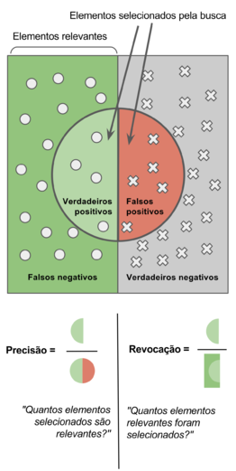
https://pt.wikipedia.org/wiki/Precis%C3%A3o_e_revoca%C3%A7%C3%A3o

Slide 30
